Slide 1
Sustainable optimization of LLMs using Bayesian surrogate-based pruning
Notes:
This project focuses on reducing the environmental impact of large language models by making pruning optimization more efficient using Bayesian surrogate models.

Slide 2
Context and Research question
Context
LLMs → high inference cost and environmental impact
Pruning reduces cost but requires many expensive experiments
Developers lack transparent tools for trade-offs
Approach
Bayesian surrogate model predicts pruning outcomes
Bayesian optimization reduces number of evaluations
Integrated into sustainability dashboard
Main Research Question
To what extent can Bayesian surrogate-based optimization guide magnitude-based pruning to reduce ecological impact while preserving performance and supporting transparent decision-making?

Slide 3
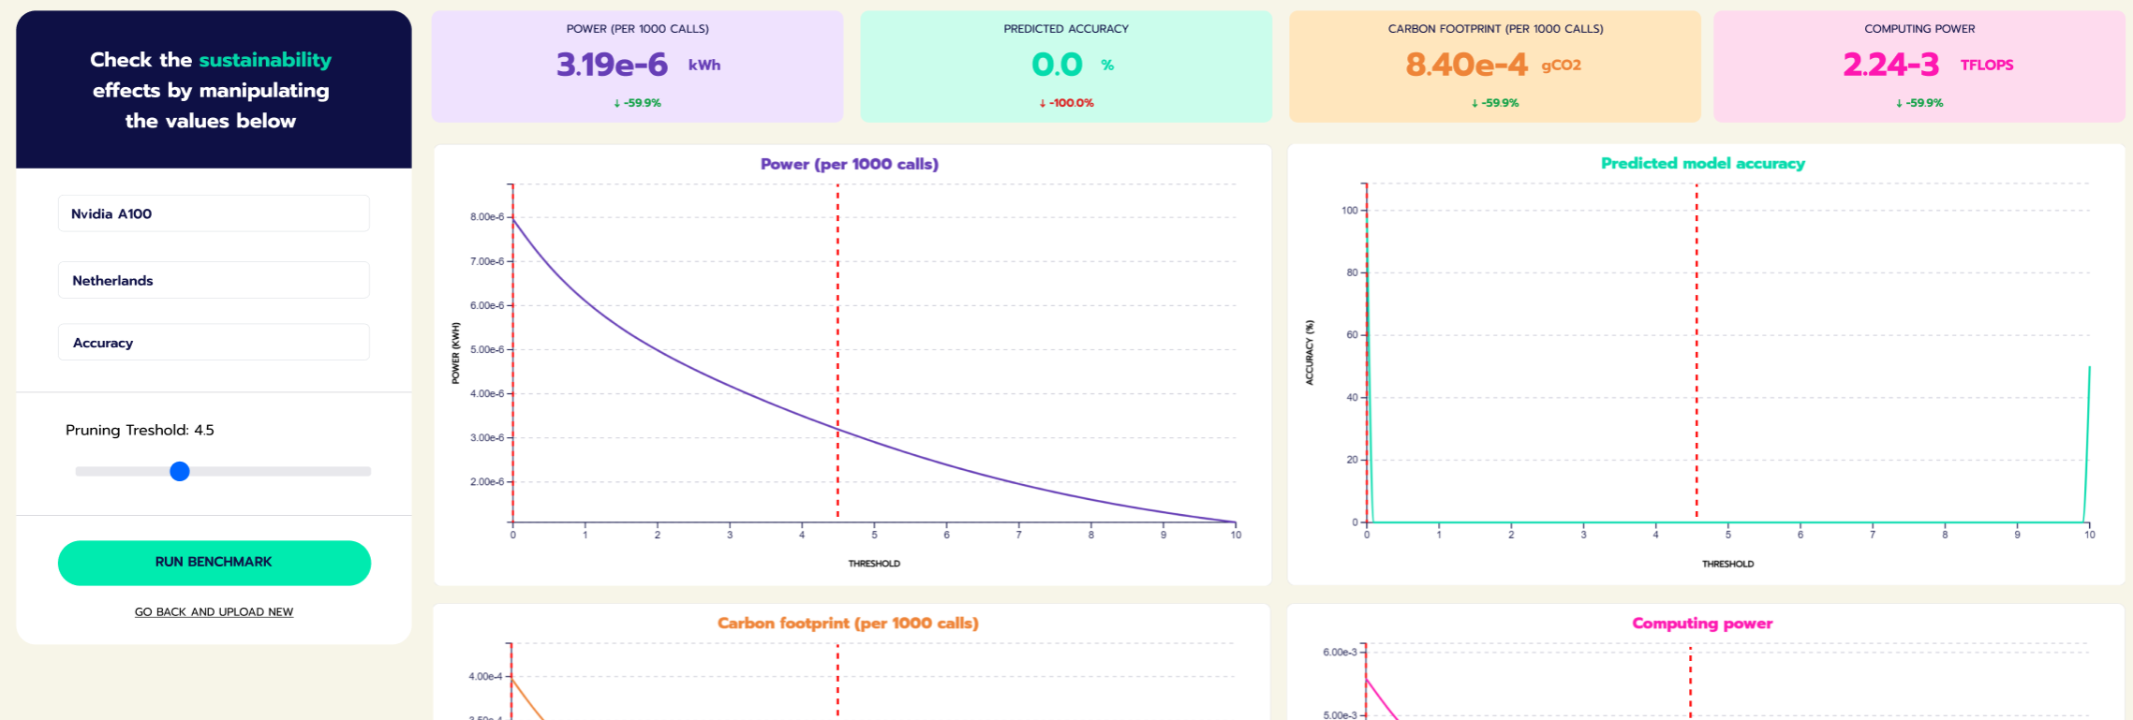
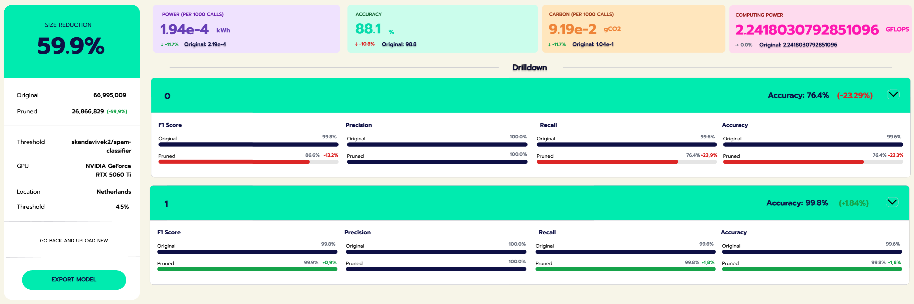

Slide 4
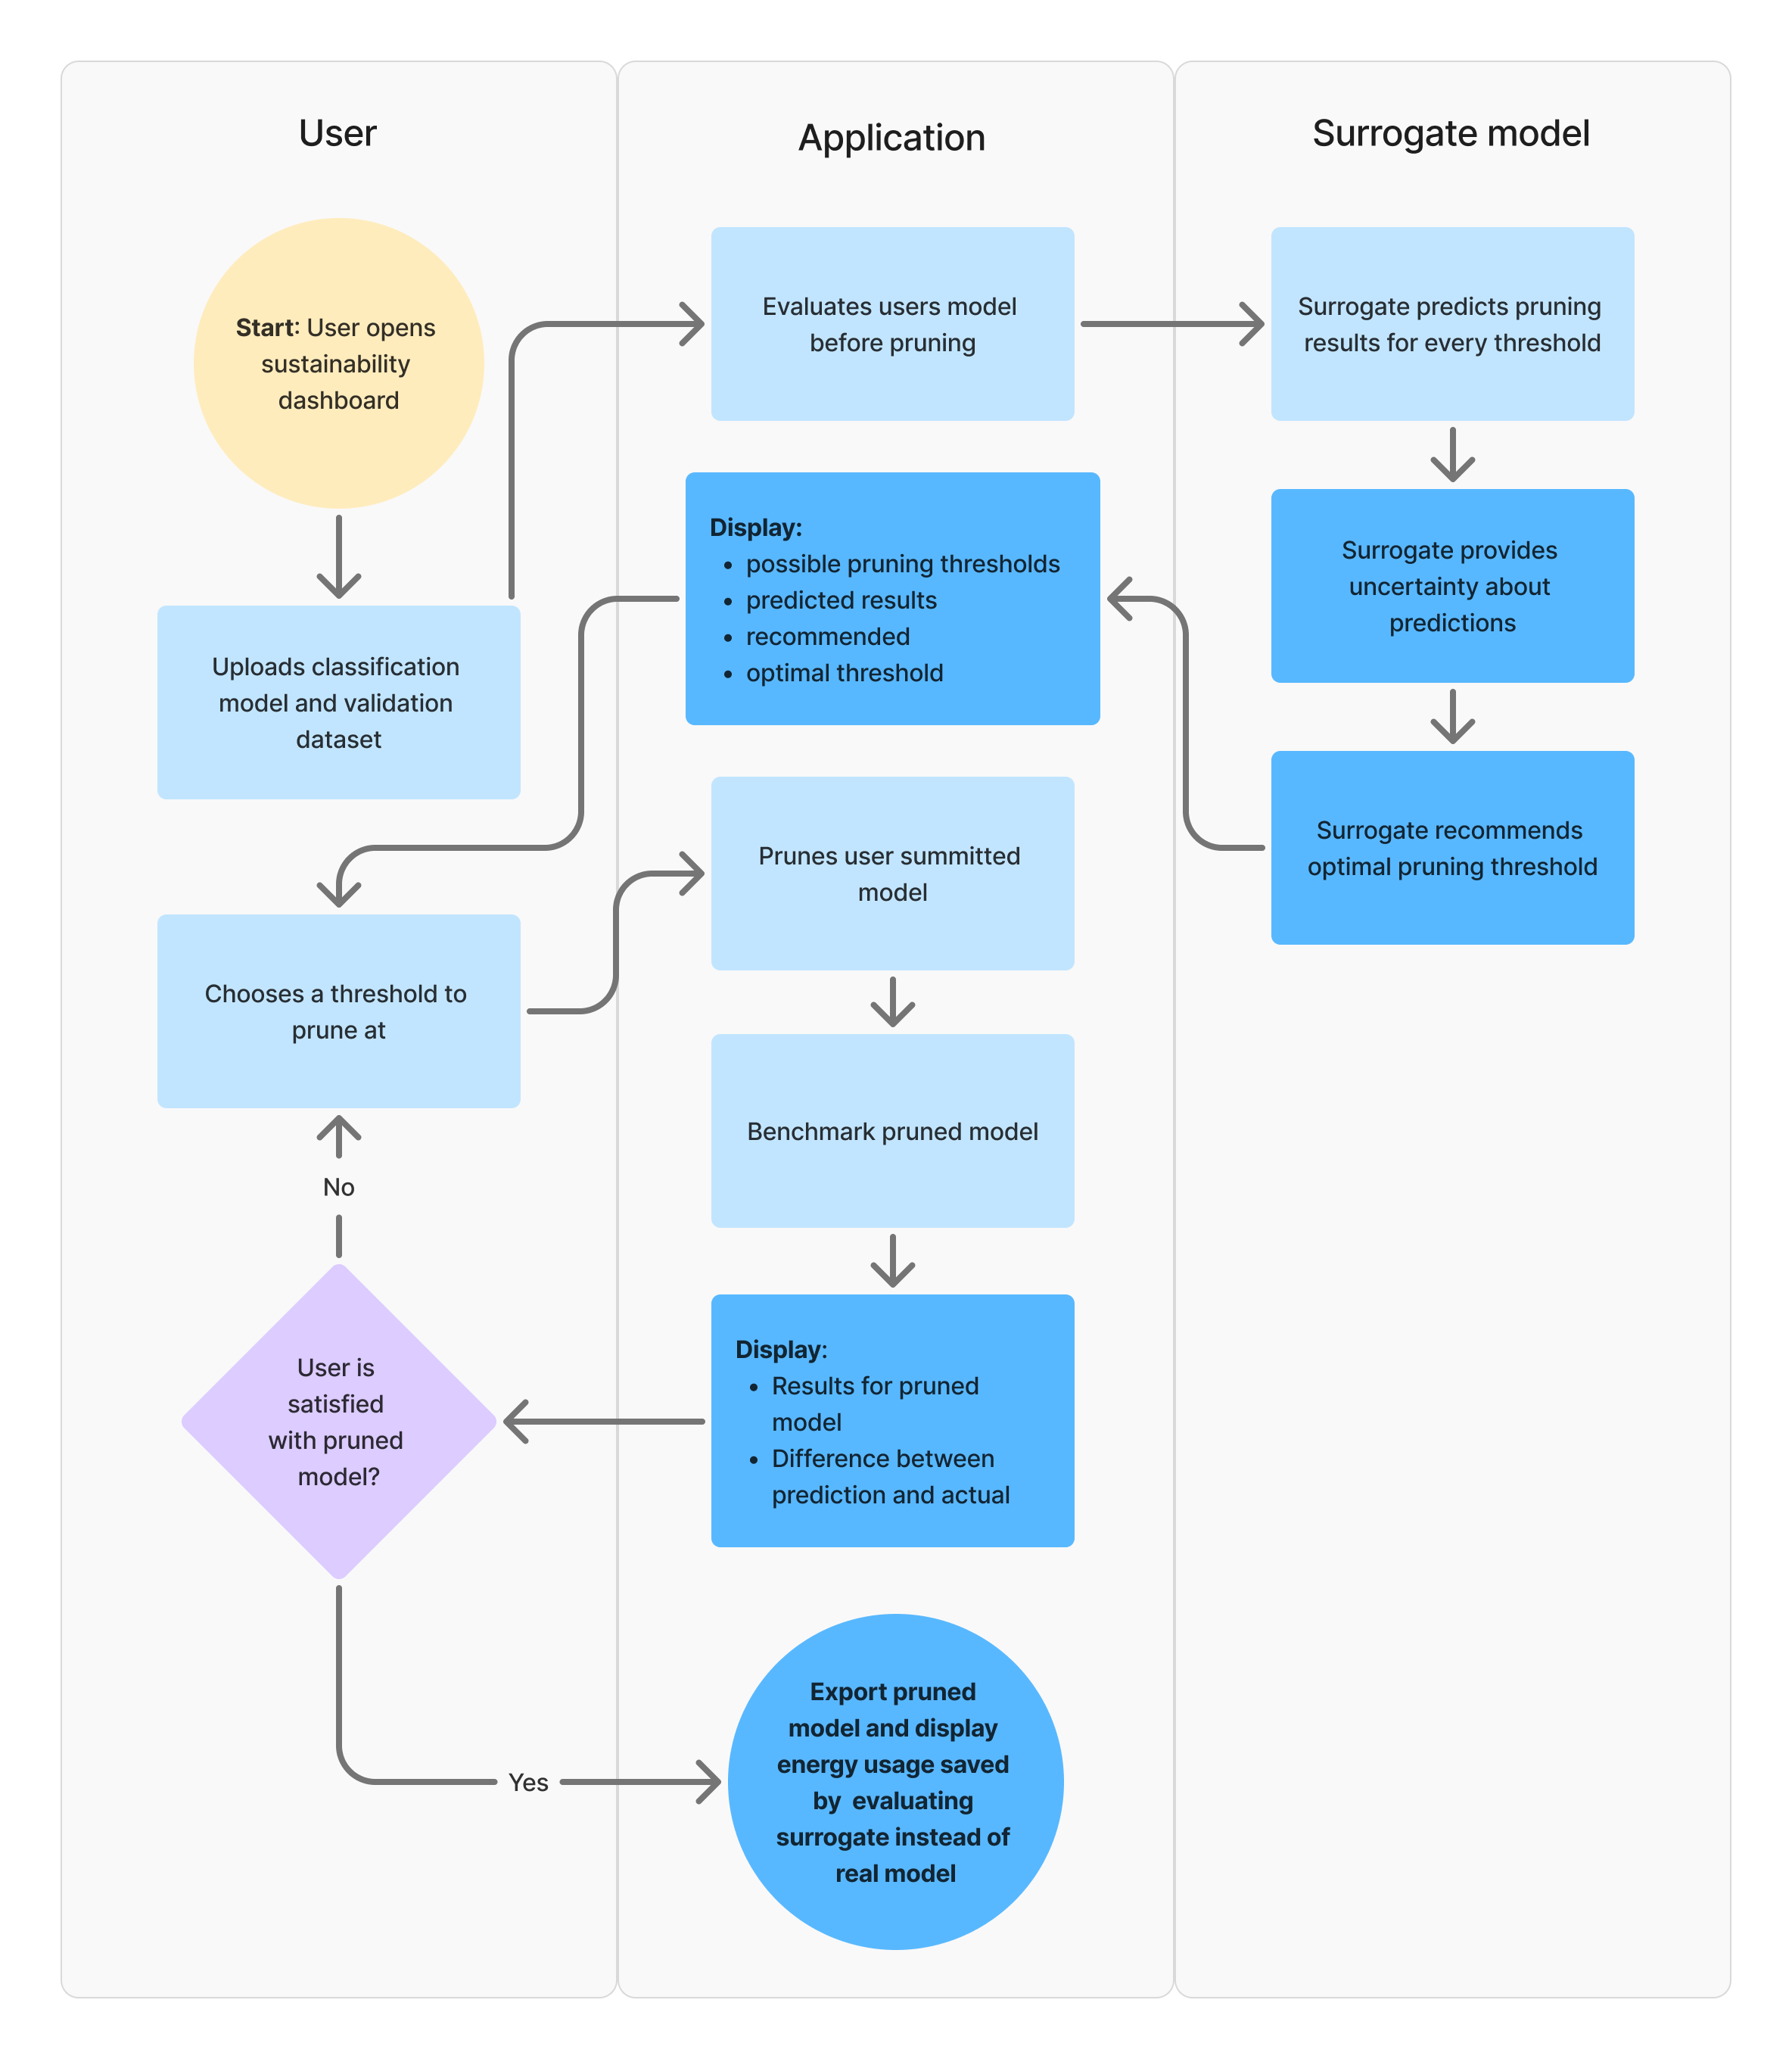
Key Requirements (from Happy Flow)
FR04: Predict performance across pruning thresholds
FR05: Visualize performance vs efficiency (FLOPs, etc.)
ER01: Ensure transparency of predictions
ER02: Maintain human control over decisions
TR03: Use Bayesian optimization to reduce evaluations

Slide 5
AI Breakdown
 | Task | Output | Potential mistakes (FP / FN) | Impact of mistakes | % mistakes where still useful | Potential solutions / mitigation
Model and benchmark dataset | Evaluate the baseline performance of the model using benchmark | Baseline perplexity | FP: Perplexity shows better result than real performance FN: Perplexity shows worse result than real performance | Low to High (Depending on severity of mistake) | 50% | Cross-validate the benchmark scoring or run it multiple times to get a more reliable result
Model | Evaluate model computing power (FLOPs), and complexity (Params) | Inference FLOPs and Model params | FP: FLOPs and or Params show as lower than actual FN: FLOPs and or Params show as higher than actual | High (Result is used for all downstream tasks) | ~10% | Run evaluation more than once for validation, compare against expected range for models of similar size
Pruning threshold and structural features (params, FLOPs) | Predict model performance (perplexity) using Bayesian surrogate | Predicted performance curve across thresholds | FP: Predicts good performance where actually bad (overestimation) FN: Predicts bad performance where actually good | Medium (Influences user decisions, but actualy pruning can show mistake) | ~30% | Use Gaussian Process with calibration, track MAE, retrain with more samples, show confidence intervals
Pruning threshold + structural features (params, FLOPs) | Estimate uncertainty of predictions (Bayesian component) | Confidence intervals / variance for each prediction | FP: Underestimates uncertainty (overconfident wrong predictions) FN: Overestimates uncertainty (too conservative) | Low (Certainty is a useful addition but with strong predictions it's less vital) | ~60% | Calibration techniques (e.g. reliability diagrams), compare predicted vs observed error, adjust kernel/prior
Predicted vs actual benchmark results | Estimate prediction error / surrogate reliability | Error metrics (MAE, calibration score) | FP: Underestimates error (trust misplaced) FN: Overestimates error (model undervalued) | Medium | ~50% | Visualize prediction vs actual gap, threshold-based warning system, disclose model might not be accurate
FLOPs + model structure | Estimate energy consumption / sustainability metrics | Energy usage (kWh), CO₂ estimate | FP: Over/underestimates energy (proxy mismatch) FN: Misses hardware-specific variation | Low | ~60% | Calibrate with real hardware measurements, provide ranges not point estimates, allow user hardware input, compare against an expected range
All predicted metrics (performance + energy) | Generate trade-off visualization (AI-assisted interpretation layer) | Pareto front / trade-off curves | FP: Misleading curve shape due to prediction errors FN: Missing optimal region | Low | ~50% | Show uncertainty bands, highlight observed vs predicted points, interactive filtering disclose model might not be accurate
User model + prior surrogate knowledge | Generalize surrogate predictions to unseen models | Predictions for new model without full retraining | FP: Poor generalization across architectures FN: Conservative predictions due to uncertainty | High | ~15–20% | Train on diverse models, include architecture embeddings, fallback to extra initial sampling

Slide 6
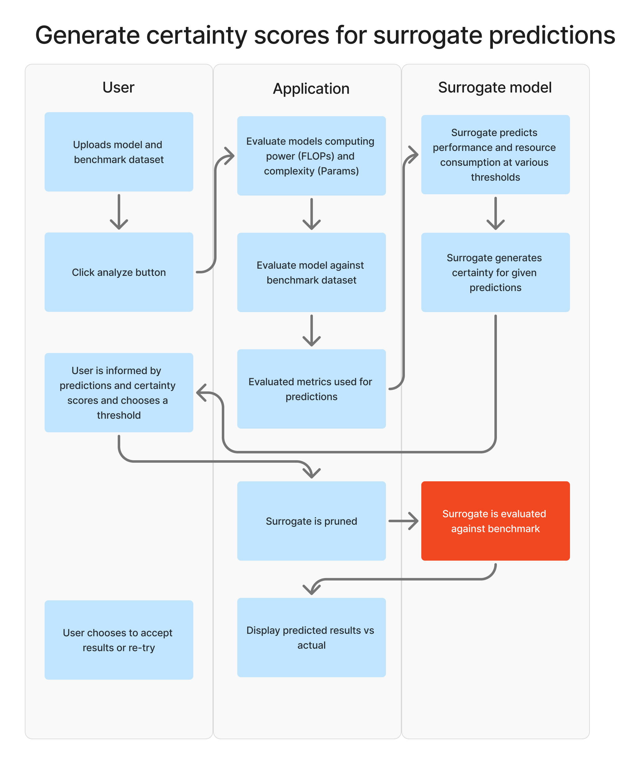
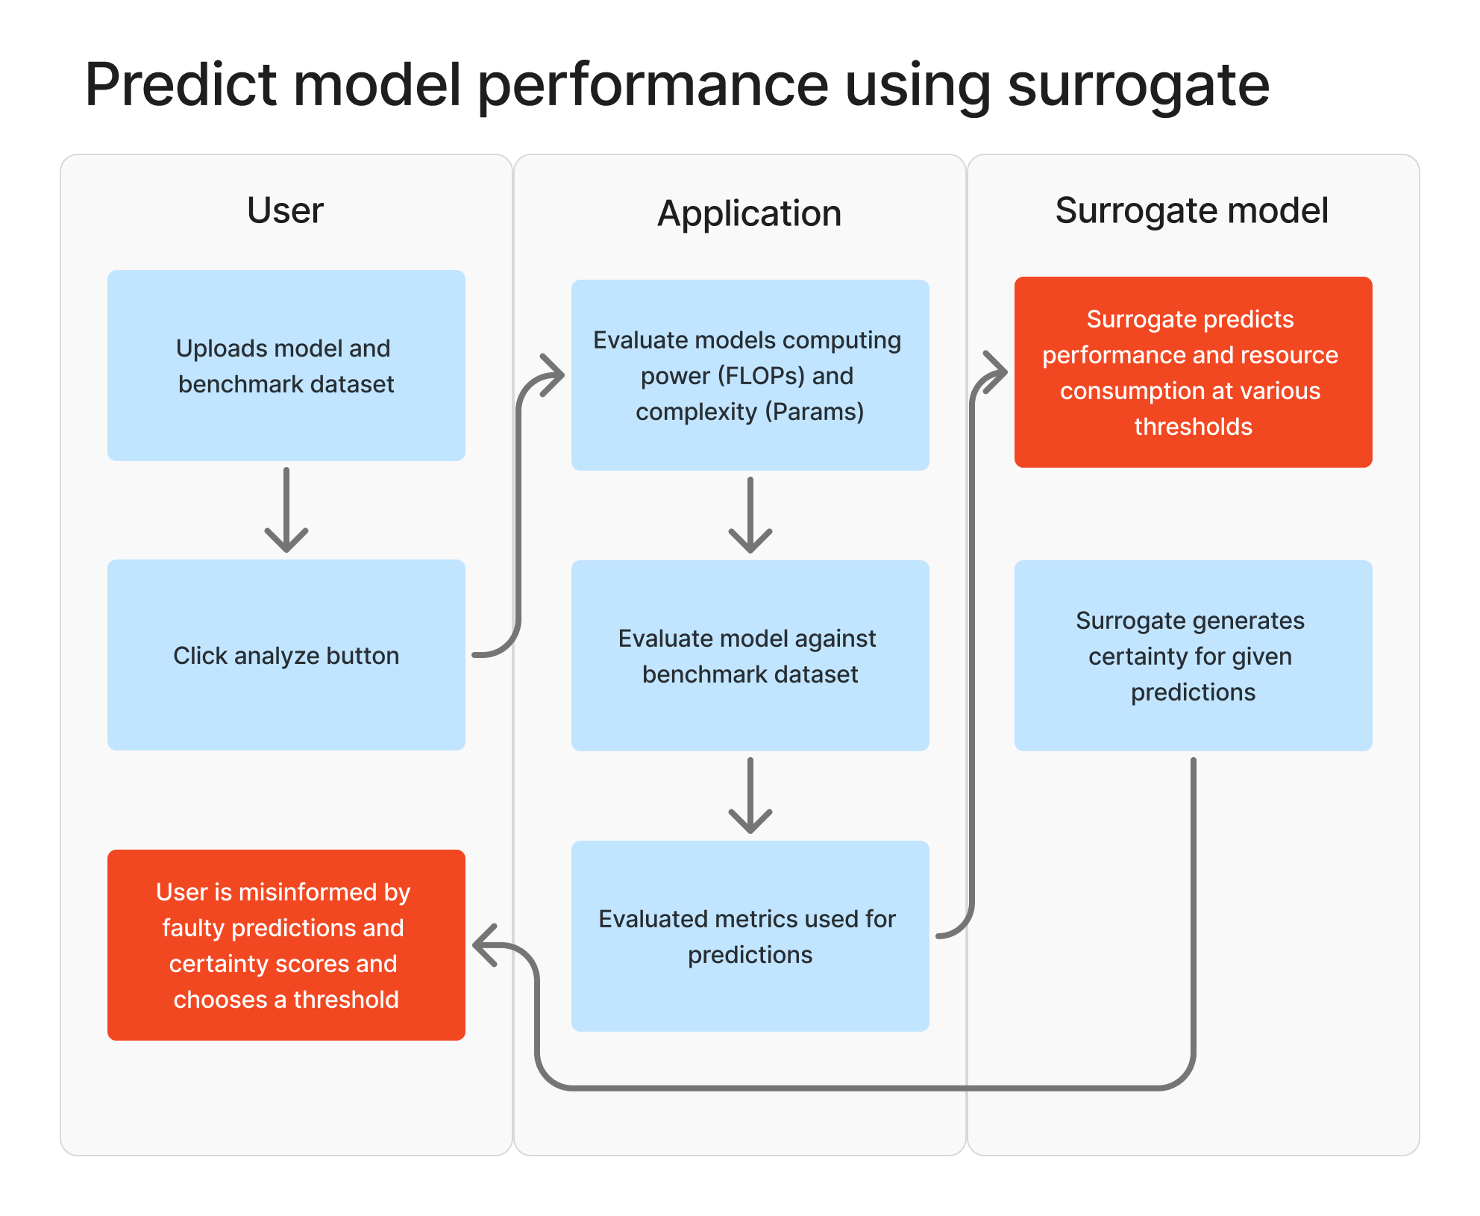
Error Flows

Slide 7
Test Plan
1. Iteration 1 – Core Flow
What: usability + basic understanding
Who: peers
How: think-aloud usability test
2. Iteration 2 – Decision Support
What: predictions, uncertainty, decisions, UX
Who: UX designers
How: scenario-based tasks
3. Iteration 3 – Final Validation
What: full workflow + errors + usefulness
Who: stakeholders
How: end-to-end testing + discussion
4. Metric Survey
What: understanding of sustainability metrics
Who: stakeholders, UX designers, engineers
How: compare visualizations (survey)
Details: https://gitlab.fdmci.hva.nl/maai/2025-2026-sem2/responsible-ai-lab/frank-velde-maai-portfolio/-/wikis/Testing-plans

